Slide 1
I Good Vegetable A
Rui Su, Peking University
Zhaoxin Chang, Institut Polytechnique de Paris
Notes:
Hello, We are the "I Good Vegetable A" team. I am Su Rui, and my teamates is ChangZhaoxin. Now we will introduce some algorithms used by our Mahjong bot.

Slide 2
Chinese Standard Mahjong
imperfect information game
Tiles
Suit:
Character 1~9 (C1~9)
Dot 1~9 (D1~9)
Bamboo 1~9 (B1~9)
Wind: Spring, Summer, Autumn, Winter (F1~4)
Dragon: Plum, Orchid, Bamboo (J1~3)
Flower (H1~8)
Each player holds 13 hand tiles at beginning
Notes:
The Chinese Standard Mahjong is an imperfect information game for four people.
The game pieces are called tiles, including 3 suits: character1~9, dot1~9 and bamboo1~9, and 4 wind tiles: spring, summer, autum and winter, 3 dragon tiles: plum orchid and bamboo. There are four tiles of each of above，and 8 bonus tile: flower1-8, one of each。The total tile number is 144.
later We will use C1 to C9 to represent Character1~9
Each player holds 13 hand tiles at the beginning.
The four players are sitting on four sides of a square table and the counterclockwise order is East, South, West, and North. The dealer is the player who seats in the East position, and in the next round, it is the South player who becomes the dealer, that is, the seating position changes so a player plays each seat in each round.

Slide 3
Chinese Standard Mahjong
Melds
Sequence: three consecutive numbers of the same suit. (C1 C2 C3)
Triplet: the same 3 tiles of Suit / Wind / Dragon. (C1 C1 C1)
Kong: the same 4 tiles of Suit / Wind / Dragon. (C1 C1 C1 C1)
Interaction with other players
Chow: form a sequence with the discarded tile. from your left-hand-player
Pung: form a Triplet
Kong: form a Kong
Notes:
There are three melds，sequence means three consecutive numbers of the same suit. For example C1C2C3. Triplet means the same 3 tiles of Suit/Wind/Dragon. For example, C1C1C1. Kong means the same 4 tiles of Suit/Wind/Dragon. For example, C1C1C1C1.
When others discard a tile, you can interact with in the following conditions.
If the tile is from your left-hand-player and you can form a sequence with it, you can Chow it.
If you can form a triplet with it, you can Pung it.
If you can form a Kong with it, you can Kong it.
For Pung and Kong, the discarded tile can come from any opponent.

Slide 4
Chinese Standard Mahjong
Win
the combination of tiles should match a specific pattern.
There are 81 patterns of Chinese Standard Mahjong, and different patterns have different score points.
The player can declare he wins.
if he reaches 8 scores, true win; else, wrong win.
Win Types
Basic: four melds + one pair
Seven Pairs: seven pairs
Thirteen Orphans: (1C 9C 1B 9B 1D 9D F1 F2 F3 F4 J1 J2 J3)
Knitted Tiles: 14 tiles from (1C 4C 7C 2B 5B 8B 3D 6D 9D F1 F2 F3 F4 J1 J2 J3)
Knitted Straight: (1C 4C 7C 2B 5B 8B 3D 6D 9D) + one meld + one pair
Notes:
To win the game, i.e., make Mahjong, the combination of tiles should match a specific pattern.
All the win patterns can be divided into five classes.
First, Basic type. consist of four melds and one pair.
Second, Seven pairs. consist of seven pairs.
Third, Thirteen Orphans. consist of .....
Fourth, Knitted Tiles. arbitrary 14 tiles from ... and can also be (1B 4B 7B 2D 5D 8D 3C 6C 9C F1 ...)
Fifth, Knitted Straight. consist of ...... and one meld and one pair. It's the same as Knitted tiles. you can change the order of C B D.

Slide 5
Competition
Every player has their own tile wall
no flowers
In the same initial state, iterate through each combination of players
time limit for C++: Each decision 1s
Notes:
In mahjong competition, in order to reduce randomness, there are the following additional rules,
The most important thing is that we use the C++ programming language, each decision time is 1s, a very short time

Slide 6
Our Method
1. Use valuation methods to calculate a rough decision
devide the hand tiles
evaluate each tile
2. Search the entire tree as much as possible in the remaining time
build the search tree
heuristically search
Notes:
Next we introduce our Method
First, we use the valuation method to calculate a rough decision. In this step, we divide the hand tile to evaluate the value of each tile in the hand.
Then we search the entire search tree as much as possible in the remaining time to reach an optimal solution. In this step, we first build a tree, and then heuristically search it.

Slide 7
Divide the Hand Tiles
For specific hand tiles, we need to divide it.
Sort the hand tiles.
Use BFS to search all of its combinations.
(C1 C2 C3 B4)
=> (C1 C2 C3 | B4) (C1 C2|C3|B4) (C1|C2 C3|B4)
(C1 C3|C2|B4) (C1|C2|C3|B4)
Notes:
First divide the hand tiles. For specific hand tiles, we first sort the hand, and then use breadth first search to find all possible combinations.
For example, with hand tiles C1C2C3B4, we can have the following combinations.

Slide 8
Divide the Hand Tiles
Define:
S := set of our hand tiles
a := first tile of S
a⁺ := next tile of a (same suit and next number)
For state S, we have six child state ==>
1. find a a⁺ a⁺⁺
2. find a * a⁺⁺
3. find * a a⁺ and a a⁺ *
4. find a a
5. find a a a
6. a for single tile
Notes:
Let's define S is the set of our hand tiles. a is the first tile of S. a+ is the next tile of a (same suit and next number)
For state S, we have six child state.
we find a a+ a++ in S, if there is, we set them a meld and remove them from S. Then we have the first child state.
If we do not find something in S, no new child states will be generated
and so on.
For all combinations that can be formed by a, we generate child states, and stop if there is no card in S, so that we have completed the division we wanted before.

Slide 9
Evaluate Each Tile
We extract all the partitions which have the minimal distance from win. (minimal singel set)
For each tile in hand, we calculate the following values.
k1 := the number of occurrences in single set (the smaller is better)
k2 := the number of neibors remainging (the bigger is better)
Calculate a weight sum for each tile
score(t) = a * k1 + b * k2
We have a rough decision now!
(C2 C3 C4 C4 B5)
=> (C2 C3 C4|C4|B5) (C2 C3| C4 C4|B5)
Notes:
with these combinations,There are good divisions and bad divisions in the previous division.
We extract all the partitions closest to winning
For example below. . . . all of them have 1 distance from win. we discard other partitions.
Then we evaluate each tile.
For each card in the hand, we calculate the following value,

Slide 10
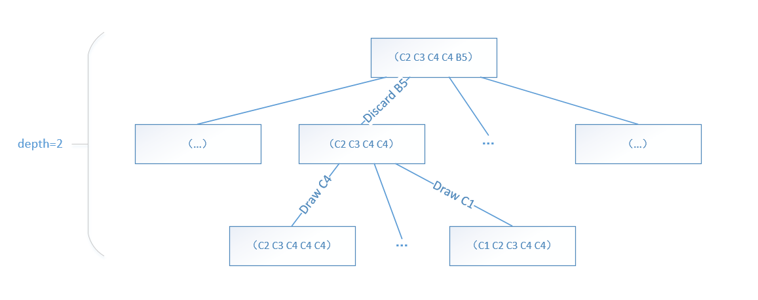
Build the Search Tree
Then we simulate discard and draw actions, build the search tree.
The tree depth is the minimal distance from win which we calculated earlier.
Notes:
After having a rough decision, we simulate discards and draws to build a search tree.
For example,
We discard every tile in our hand, generate these child nodes, and then draw each card from the pool, and then generate the next child nodes,
The depth of the tree is set to the minimum winning distance we calculated earlier.
In this way, it is impossible for internal nodes to win, and there must be some leaf nodes that can win. We only need to check whether the leaf node wins. Can save a lot of time.

Slide 11
Heuristicly Search
We multiply the remaining number of tiles, which is drawn on the path to leaf node.
The result represents the probability of winning
Notes:
Next we search the entire tree from the root node.
At each leaf node, if we can win, we multiply the number of cards drawn on the path, and the result can represent the probability of winning.
We only need to sum all the possible wins in the case of discarding B5, Then we can get the probability of winning when B5 is discarded.
So we can have an optimal decision.

Slide 12
Heuristicly Search
We search from worst to best tiles in our hand.
If one tile's winning probability is less than the worst tile, then we choose it as the worst tile.
(C2 C3 C4 C4 B5)
For example, P(Win | Discard B5) = 0.3, but P(Win | Discard C4) = 0.2, then we choose to discard C4. If the time is up, we also have a better choice than before, even though we did not search the entire tree.
Notes:
In most cases, we cannot search through all the tree, but we can always search the worst two or three candidate tiles.
So we start to search from worst to best in the previous rough decision.
If ....
For example: we can see that the worst card in C2C3C4C4B5 is B5, but if we calculate that the winning probability of discarding B5 is greater than the probability of discarding C4, we choose to lose C4.
In this way, if time is up, we have a better decision, even though we did not search the entire tree.

Slide 13
Interaction Method
This part is really simple.
When we can CHI/PENG/GANG, we compare the minimal deficiency before CHI/PENG/GANG and after CHI/PENG/GANG.
If the minimal deficiency is reduced, we choose to CHI/PENG/GANG.
Notes:
For interacting with other people, this part is really simple.
When we can chipenggang, we compare the minimum winning distance before and after chipenggang
If the minimum winning distance is reduced, we choose chipenggang

Slide 14
Thanks!
Notes:
These are methods we used in our Mahjong bot.
thank you。

